Slide 1
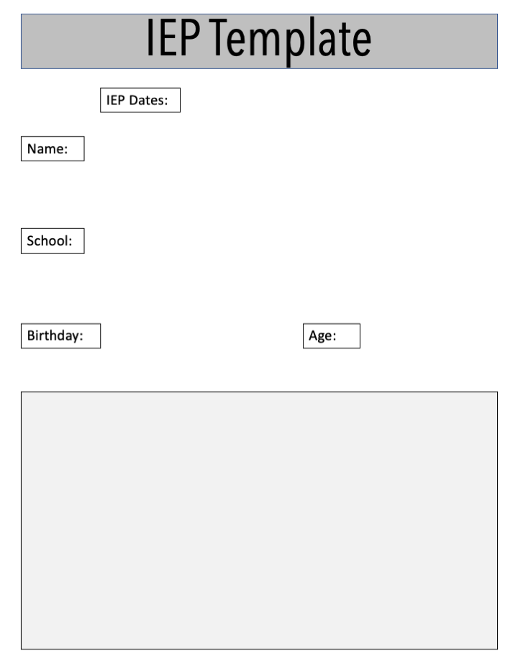
February 17,2022 - March 8, 2022
Maria Sutter
Hilltop Elementary School
August 17, 2016
5 years and 6 months
Parents:
Rita Sutter - biological mother and Jose stepfather - biological father died of a heroin overdose
Teacher:
Ms. Brylee
Occupational Therapist:
Ms.Claudia

Slide 2
(placement, educational background, diagnosis-when, attributes interests. )
Kind
Has friends
Very good at math
Maria is currently in a regular classroom.
She has been in preschool but had a break before Kindergarten.
The Occupational Therapist said that Maria is doing better with the therapy and able to hold her pencil correctly.
Reading/language therapist: Maria is doing better with her sight words and being able to identify them.
Sight words worksheet: 22 out of 44
Spelling Test one: 5/10
Spelling test two: 6/10

Slide 3
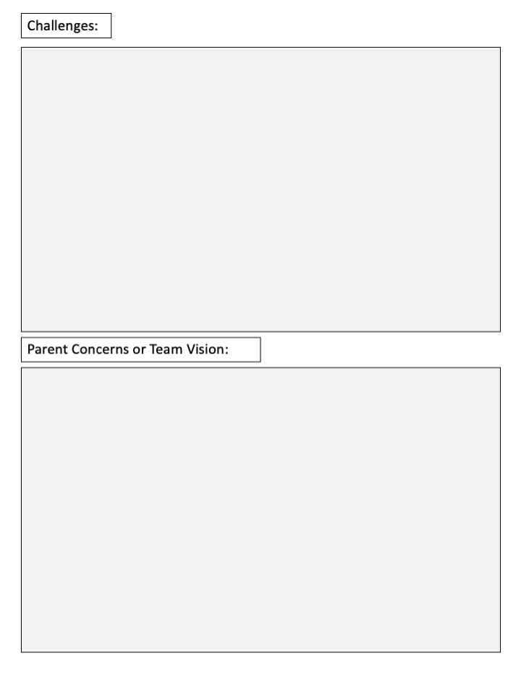
Maria has shown challenges with her sight word, and low performance in writing. She holds her pencil with a pincer grasp. Something that challenges Maria is reading. Her being just a couple levels behind in kindergarten will only set her further behind, because Kindergarten moves at a rapid pace.
Maria’s mother has expressed she thinks there may be some social disconnect with fellow classmates. She has told us she wants her to be intelligent and not behind in any way.
Our team vision for Maria is to meet all the concerns of the parents. We want her to read at her level or above. We need to find ways to build her knowledge of the words she is reading. Also the way she comprehends the books she is reading.

Slide 4
Writes letters effectively
Colors within lines
Writes name
Knows her address
Names 12 colors
Names basic shapes
Counts to 100
Counts objects/understands one-to-one correspondence
Can add and subtract, but has not memorized math facts
Holds books correctly and understands that the words on the page represent the words read to her
Uses plurals correctly
Speaks clearly and has typical expressive and receptive language abilities
reading at the 5 years, 2 months level
spelling at the 5 years, 4 months level
follows two-step directions, but struggles with three-steps
struggles with sight words
uses phonics to sound out words
plays well with other children
is appropriately affectionate
demonstrates behaviors associated with happiness, sadness, frustration, anger, joy, attachment, surprise, and trust
capable of reciprocal turn-taking
has friends of both genders
wishes to please others
runs, skips, gallops, hops, and jumps
snaps, buttons, zips, and ties
grasps pencils and crayons with pincer grasp
has no difficulty with tasks that cross the midline
throws and catches large ball
throws and usually catches small ball
climbs stairs independently
climbs on playground equipment
drinks from a cup and uses a straw
eats with utensils
Right-handed
Cuts with scissors effectively

Slide 5
What you can do to support child through the day
Read aloud
Audio book for grade level text
Visual schedule
Pre-written directions
Technology
What you can do to change the lesson for the benefit
Reading teacher will come in during class to work on reading skills

Slide 6
Writing
She has a pincer grasp
By the end of the year full capability to write in a Dynamic Tripod Grasp, and able to understand her handwriting
Monitor every Friday on how she holds her pencil
Informal assessment such as spelling tests, and any written assignments
Modeling the correct grasp demonstrated by a teacher
Using a pencil gribby designated with the correct dynamic tripod/quadruped grasp

Slide 7
Reading Sight Words
Maria is able to sight 22 out of the 44 on the worksheet.
We would like Maria to get 44 out of the 44 on the worksheet.
It will be measured by the worksheet that is given to Maria.
Maria will be doing this worksheet every week on a Friday.
she is able to do that worksheet we will be shuffling the sight words.

Slide 8
IReady
Distraction free
more time
Reading the questions if she needs help

